Slide 1
Medical Image Analysis with CNNs
Matthew Engelhard

Slide 2
Overview
Intuition on feature hierarchy
Esteva et al as a jumping off point to discuss:
How do we adapt an existing model to classify medical images?
Why is it a good idea to do this?
How do we get labels for medical image classification tasks, and how “good” do they have to be?
How do we look inside the black box?
Preprocessing details for images
Notes:
The idea here: we’ll use esteva et al as a jumping off point to look into how we actually get this done.

Slide 3
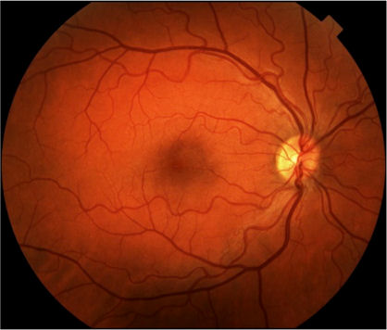
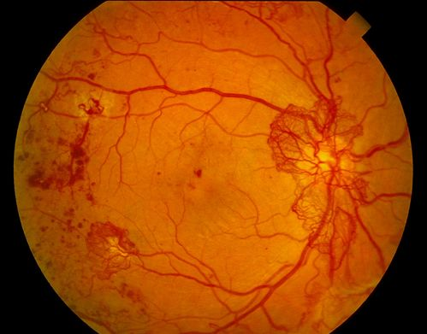

Deep Learning for Image Analysis
Diabetic Retinopathy Classification
Healthy Retina
Unhealthy Retina
Notes:
Let’s compare this task to mortality prediction based on ICU variables.
ICU variables – risk depends directly on these variables
What does healthy vs unhealthy retina depend on?
Well, probably on whether we see hemorrhages, proliferation
But what’s a hemorrhage – the computer doesn’t have an indicator for hemorrhage
We’ll it’s a…
So, to understand these complex features of images – like hemorrhage and proliferation
The model has to build its understanding of those things on top of simple features

Slide 4
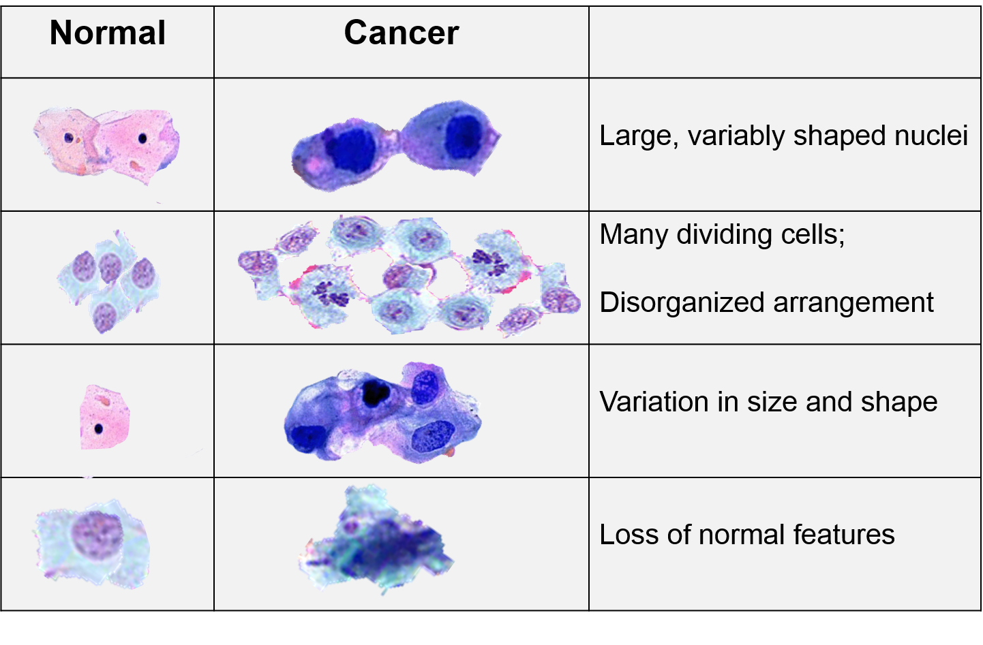
To identify cancerous cells, first learn to identify cells and their components.
https://sphweb.bumc.bu.edu/otlt/mph-modules/ph/ph709_cancer/ph709_cancer7.html
Notes:
This is what the CNN does. A hierarchy of understanding.

Slide 5
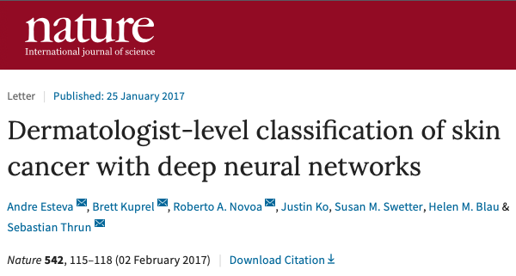
Medical Image Classification
Identifying Skin Cancer
Notes:
Great paper
Brings lots of important issues into focus
Will address some of the questions I saw from the survey.

Slide 6
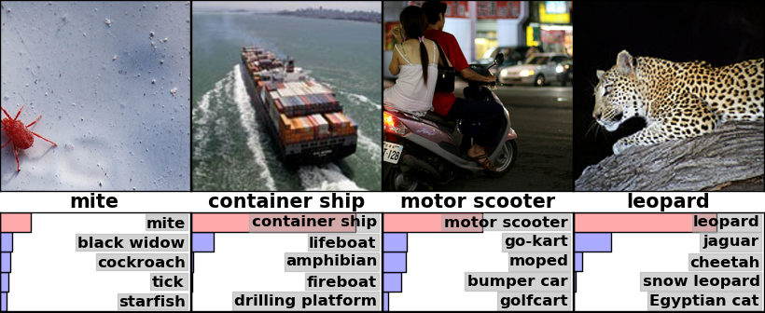
A Classification Task: predict the label associated with each image
Notes:
Start with the most important and fundamental question here:
How do we adapt a pre-trained model to a new task
And why would we do that??
To reorient you, we’re almost always talking classification
We’ll look at some other medically relevant tasks next time.
Output is distribution over output classes
Note that some images match multiple labels
Training data: whole-image labels

Slide 7
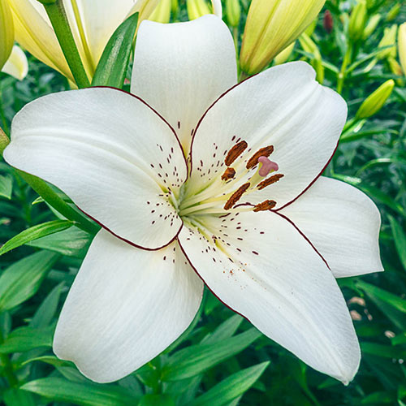
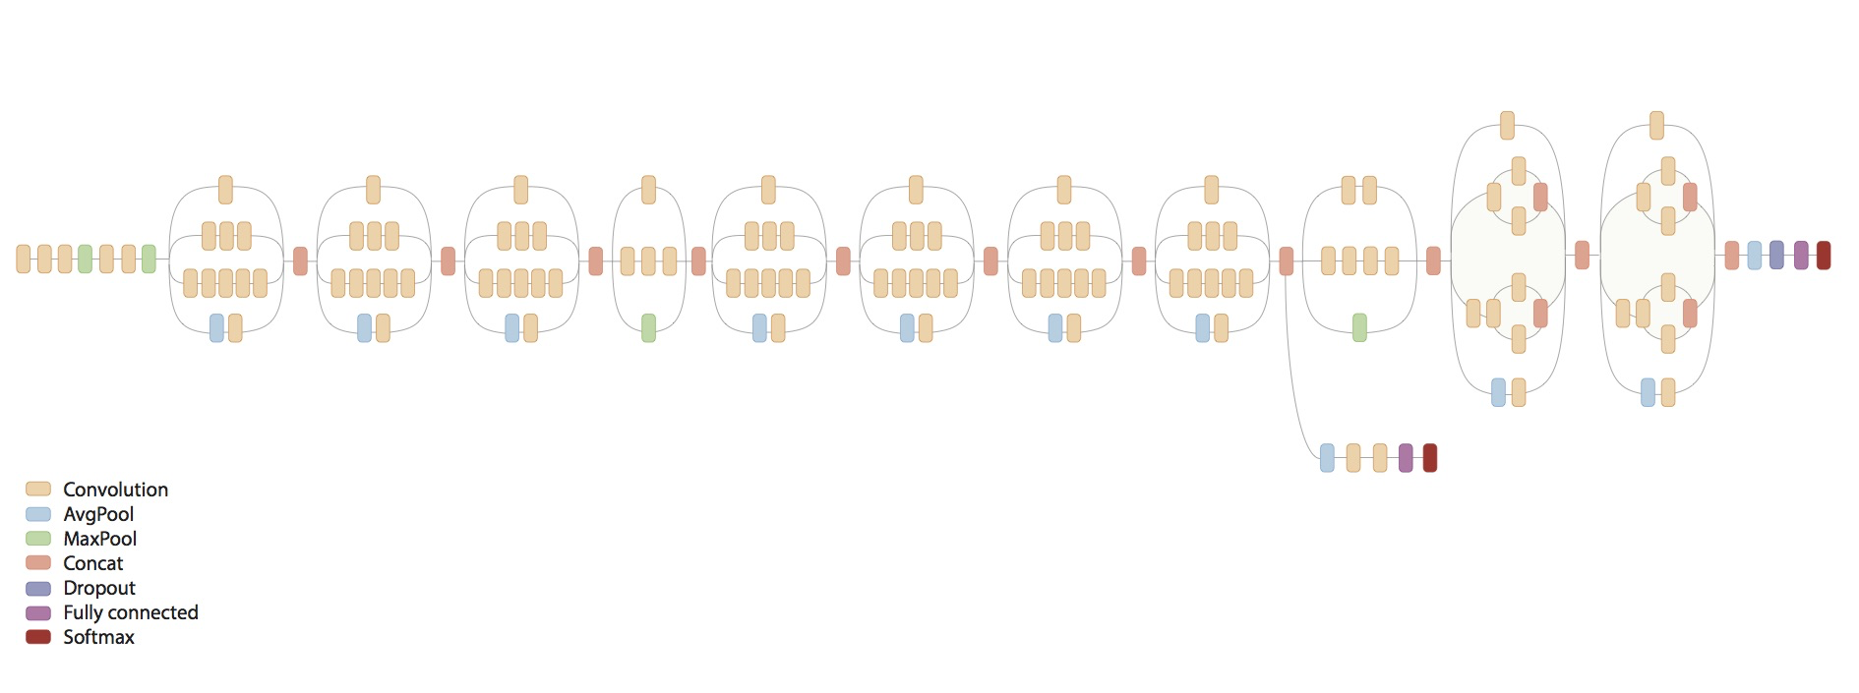
Take a model trained on naturalistic images...
Lily
Notes:
Take an existing model – Inception v3
Picture of lily goes in
A bunch of shit in the middle
’lily’ prediction comes out

Slide 8
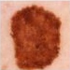
…and repurpose it to evaluate medical images
Melanoma
Notes:
First, WHY are we doing this?
Good idea to reuse our filters
Lots of things we’ve discovered in these architectures
So here, we’re doing the same thing – not only are we taking the model structure, i.e. the architecture, but also the trained parameters

Slide 9
Repurposing our model
Step 1: Modify the architecture
Step 2: Fine-tune the parameters
Notes:
Now, WHY is this a good idea?
It goes back to the hierarchy…
And look, if we HAVE a million medical images, then we can probably just train from scratch on those images
let it learn a new, effective hierarchy from the ground up
More often, we just don’t have the volume, so instead we want to take an existing model and tweak it – we say “fine-tune” it -- to the new problem
We’ll come back to the why – for now let’s focus more on how we do it
Describe each very briefly
We’ll talk about each, in turn.

Slide 10
Classifier Output:
Two-Class (e.g. Yes/No)
Diabetic retinopathy? (Yes/No)
Gulshan et al. JAMA (2016)
Notes:
First, let’s think about why, and how, we have to modify the architecture
To do that, we’ll think a little bit about the classification problems we’ve considered so far
And how that relates to the architecture we’ll need
Diabetic retinopathy: binary predictions

Slide 11
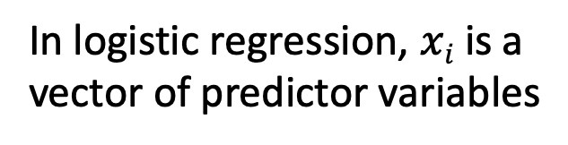

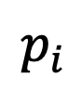
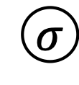
Two-Class Predictions
$$p_{i}$$
$$σ$$
$$σ\left(zi\right)=\frac{e^{zi}}{1+e^{zi}}$$
z_{i}
b₁
b_{M}
x_{i1}
x_{iM}
In logistic regression, $xi$ is a
vector of predictor variables
Notes:
So, the final portions of the retinopathy prediction architecture look like logistic regression
The difference is these features. Instead, we have a deep CNN

Slide 12
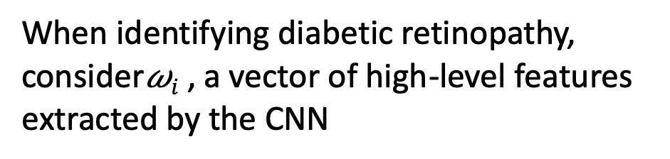
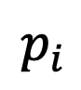

Two-Class Predictions
$$p_{i}$$
$$σ$$
z_{i}
$$σ\left(zi\right)=\frac{e^{zi}}{1+e^{zi}}$$
b₁
b_{M}
𝜔_{i1}
𝜔_{iM}
When identifying diabetic retinopathy,
consider𝜔$i$ , a vector of high-level features
extracted by the CNN
Convolutional Neural Network

Slide 13
Classifier Output:
Multi-Class (ImageNet)
Image Label? (1000 classes)
Notes:
We want to use Inception v3
But there’s a mismatch.
It’s not just that the best parameters might be a little bit different
This model generates a different output

Slide 14
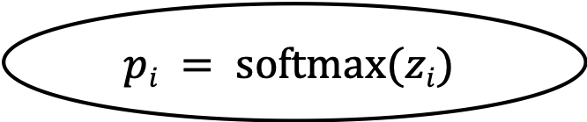
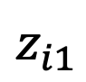
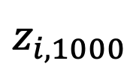
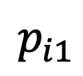
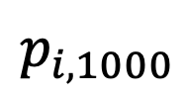
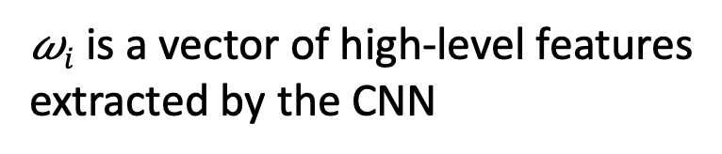
Multi-Class Predictions
$$p_{i1}$$
$$p_{i,1000}$$
$$pi = softmax(zi)$$
$$z_{i1}$$
$$z_{i,1000}$$
fully connected
𝜔_{i1}
𝜔_{iM}
𝜔$i$ is a vector of high-level features
extracted by the CNN
Convolutional Neural Network
Notes:
Differences: logit layer: size 1 to size 1000
Probability layer: size 1 to size 1000

Slide 15
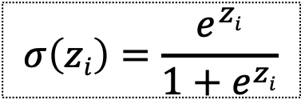
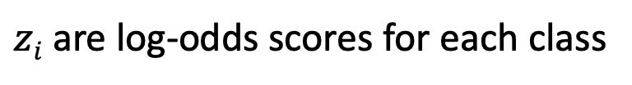
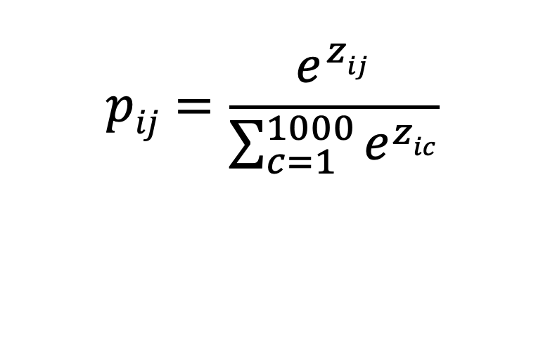
Multi-Class Predictions
$$pij=\frac{e^{zij}}{\sum_{c=1}^{1000}{e^{zic}}}$$
$$p_{i1}$$
$$p_{i,1000}$$
$$pi = softmax(zi)$$
$$σ\left(zi\right)=\frac{e^{zi}}{1+e^{zi}}$$
$$z_{i1}$$
$$z_{i,1000}$$
$zi$ are log-odds scores for each class
fully connected
𝜔_{i1}
𝜔_{iM}
𝜔$i$ is a vector of high-level features
extracted by the CNN
Convolutional Neural Network
Notes:
We’ve talked about how we convert logits – i.e. log odds – to probabilities.
(go through it): log-odds -> odds -> probability
Softmax is two steps: first exponentiate
Then normalize the vector to sum to 1.

Slide 16
Classifier Output:
Multi-Class (Lesion Type)
Type of Skin Lesion? (757 classes)
Esteva et al. Nature (2017)
Notes:
For skin lesions, the architecture would be a little different yet again…

Slide 17
Step 1: Modify the Architecture
$$p_{i1}$$
$$p_{i,1000}$$
1000 training classes
757 training classes
$$pi = softmax(zi)$$
$$z_{i1}$$
$$z_{i,1000}$$
fully connected
𝜔_{i1}
𝜔_{iM}
𝜔$i$ is a vector of high-level features
extracted by the CNN
Convolutional Neural Network
Notes:
So, concretely
We have a pre-trained Inception v3 model
What do we do to it…

Slide 18
Step 1: Modify the Architecture
1000 training classes
757 training classes
𝜔_{i1}
𝜔_{iM}
𝜔$i$ is a vector of high-level features
extracted by the CNN
Convolutional Neural Network

Slide 19
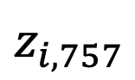
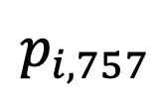
Step 1: Modify the Architecture
$$p_{i1}$$
$$p_{i,757}$$
$$pi = softmax(zi)$$
New layers with randomly initialized weights
$$z_{i1}$$
$$z_{i,757}$$
fully connected
𝜔_{i1}
𝜔_{iM}
𝜔$i$ is a vector of high-level features
extracted by the CNN
Convolutional Neural Network

Slide 20
Step 2: fine-tune the parameters
This just means we train the model.
The only difference is that normally, when we train the model, we start with randomly selected parameters
This time, we start with parameters from the original model
Everything else is the same: we follow the gradient to reduce the cross-entropy loss as much as we can
Notes:
At this point, we’re about halfway done:
We know what quantity we ought to be minimizing, but we’re not sure how to actually get there.
We need a strategy for finding parameters that actually minimize this value – or at least, a strategy for reducing it

Slide 21
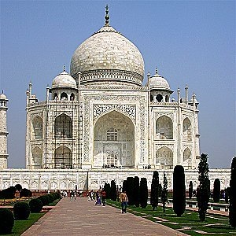
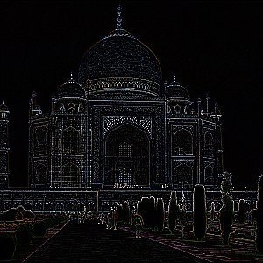
Why is pre-training a good idea?
A filter that detects edges may be useful for many classification tasks.
https://docs.gimp.org/en/plug-in-convmatrix.html
Every model needs an edge detector… why waste time re-learning it?

Slide 22
Pre-training, in brief
fine-tuning a pre-trained model tends to be at least as good as learning from scratch
(empirical result)
2) freeze early layers and fine-tune later layers
more data → fine-tune more layers
3) best tuning depth depends on the application, and should be explored
Notes:
~130k images -> they fine-tune all layers

Slide 23
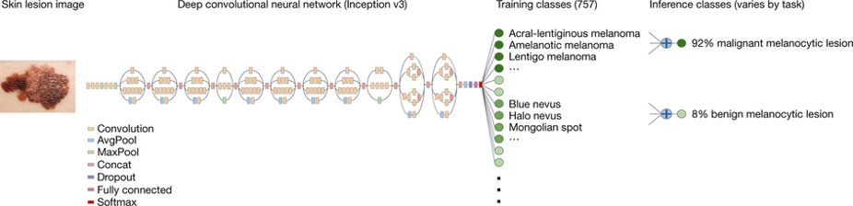
Repurposing the Inception v3 CNN
Begin with a model trained on ImageNet (to classify everyday images)
Modify the architecture to match the new number of training classes
Fine-tune parameters using images of skin lesions
Notes:
Briefly mention additional details, e.g. learning rate (0.001), decay factor, optimizer, random rotation and flip of images

Slide 24
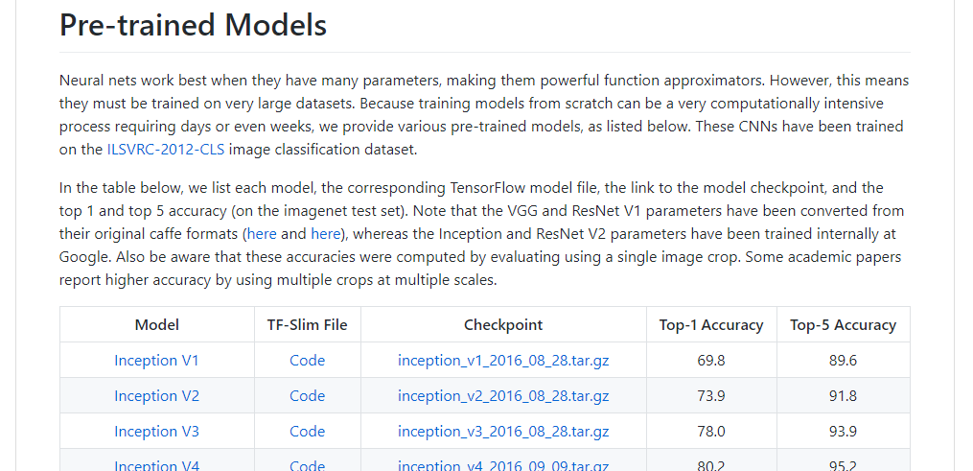
Inception v3 and many other models are freely available
TF-Slim Code:
Defines the model architecture
Checkpoint File:
Trained model parameters
https://github.com/tensorflow/models/tree/master/research/slim#Pretrained
Notes:
CODE -> architecture
CHECKPOINT -> parameters

Slide 25
“Ground Truth” in Medicine
What should the labels be, and how do we get a lot of them?

Slide 26
Two Types of Labels, Two Rounds of Evaluation
Model development: predict dermatologists’ annotations:
Three-class disease partition
Nine-class disease partition
Model evaluation: predict biopsy result (benign vs malignant)
Keratinocyte carcinoma vs benign seborrheic keratosis
Malignant melanoma vs benign nevus
Standard images
Dermoscopy
Notes:
The “gold standard” is hard to come by… so they do something that is pretty clever.
They’ll use the annotations for training – let’s assume they’re good enough

Slide 27
Specifying training classes based on taxonomy of lesions
Disease Partitioning Algorithm:
Ascend the tree until the current node contains <1000 images across all child nodes. Add these images as a distinct training class.
This resulted in 757 training classes.
However, performance was assessed based on higher-level nodes.
Notes:
Go too far up and we’re identifying dissimilar things
Go too far down and we don’t have enough examples
Broader issue here – what’s the right level of prediction?

Slide 28
MALIGNANT LESION
CUTAENOUS LYMPHOMA
DERMAL
Use these as training classes?
-> Too few examples to learn effectively
T-CELL
B-CELL
ANGIOSARCOMA
MERKEL CELL CARCINOMA
Notes:
May also have similar appearance
Note that appearance is not the same as the taxonomy

Slide 29
Use these as training classes?
-> Too much variability in appearance
MALIGNANT LESION
CUTAENOUS LYMPHOMA
DERMAL
T-CELL
B-CELL
ANGIOSARCOMA
MERKEL CELL CARCINOMA

Slide 30
MALIGNANT LESION
CUTAENOUS LYMPHOMA
DERMAL
Use these as training classes.
-> Allows effective learning
T-CELL
B-CELL
ANGIOSARCOMA
MERKEL CELL CARCINOMA
Notes:
But evaluation still takes place at the benign / malignant level

Slide 31
Classification Results
Interpreting the ROC Curve

Slide 32
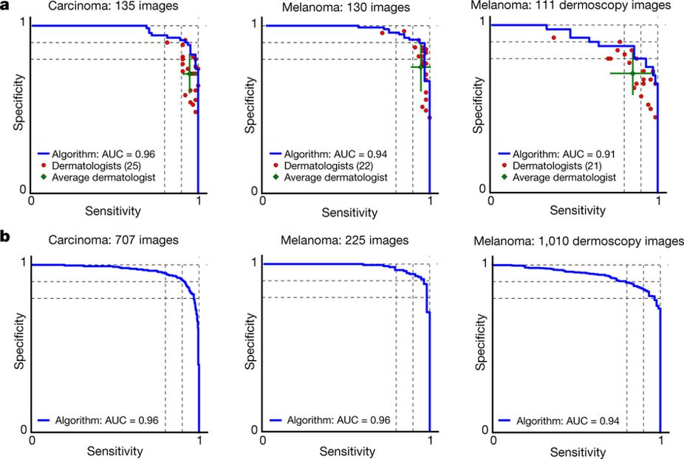
Results: CNN Performance vs Dermatologists
Notes:
Our CNN is tested against at least 21 dermatologists at keratinocyte carcinoma and melanoma recognition. For each test, previously unseen, biopsy-proven images of lesions are displayed, and dermatologists are asked if they would: biopsy/treat the lesion or reassure the patient.
Melanocytic test: 33 malignant melanomas and 97 benign nevi. A second melanocytic test using dermoscopic images is displayed for comparison: 71 malignant and 40 benign.

Slide 33
Model Interpretation
How do the authors attempt to look inside the “black box”?

Slide 34
Two competing perspectives
Clinicians must fully understand how their diagnostic tools work
Clinicians must be sure these tools are valid and reliable
Notes:
At the end of the day there are two competing perspectives.
Those that think we must fully understand how these tools work to trust them
And those who think that we just need to know that they DO work.
But that means rigorously and repeatedly validating them, in a variety of settings – health systems, patient populations, other conditions

Slide 35
Machine Learning: A Black Box?
Skin Lesion Type
Notes:
I have to know what it’s doing, or I can’t trust it!

Slide 36
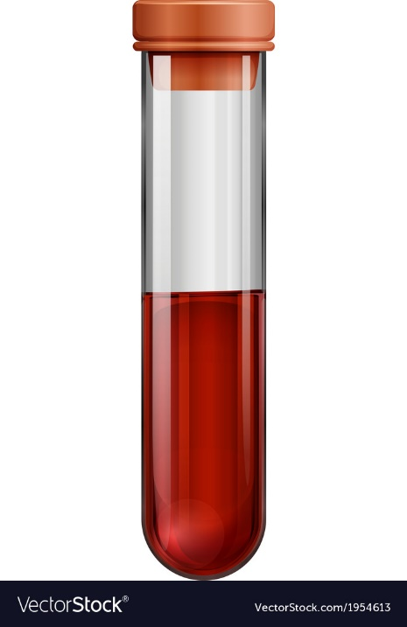
Prostate-specific antigen measurement: A Black Box?
PSA Level
Notes:
I have no idea what PSA is or how it’s measured… do you?

Slide 37
Saliency maps for example images
Saliency maps show gradients for each pixel with respect to the CNN’s loss function. Darker pixels represent those with more influence.
Q: How much does this visualization help us understand the model?

Slide 38
Data Preprocessing / Augmentation
Sometimes the details matter…

Slide 39
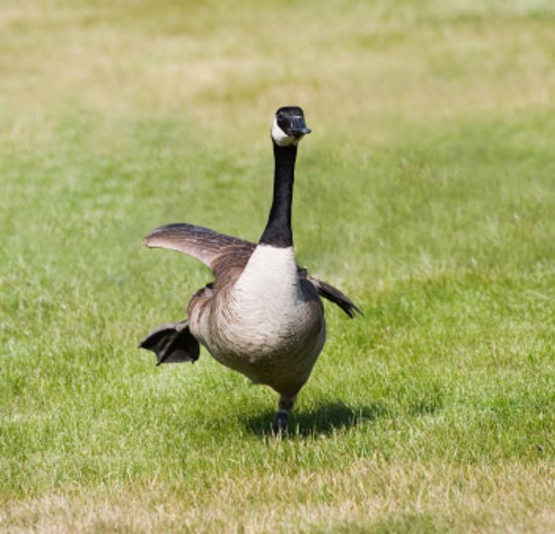
I know this one, it’s a goose!

Slide 40
I have no idea what this is.

Slide 41
I’ve never seen anything like it in my life.

Slide 42
I don’t see anything.

Slide 43
I’m certain this is a space shuttle.

Slide 44
Solution: Augment your dataset
The details depend on the application.

